Slide 1
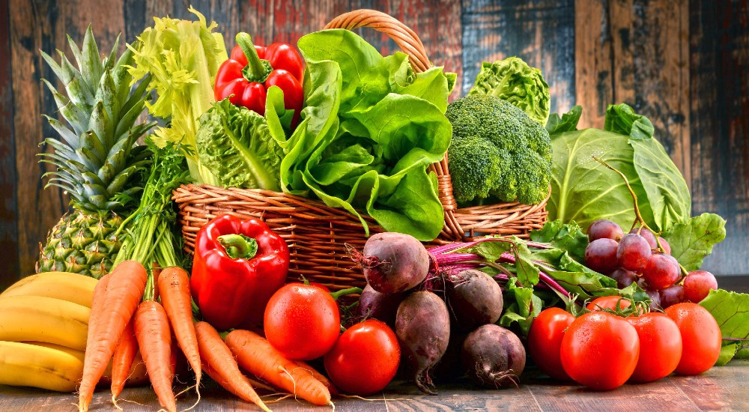
Pitch
Deck
Online Farmers Market
Presentation

Slide 2

Intro
Empowering farmers through Multi_Vendor access
Online Farmer's Market
Page 2

Slide 3
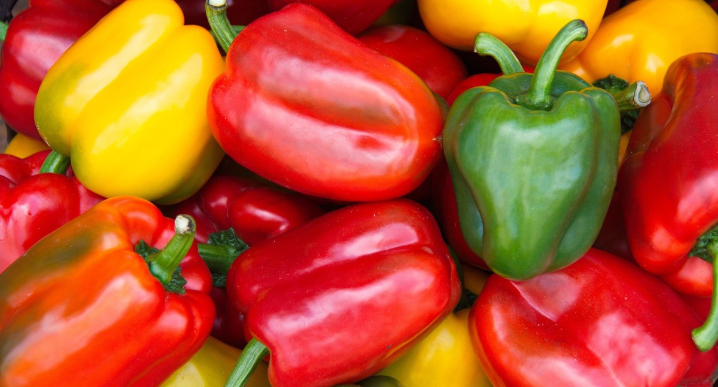
Problem
The agriculture industry is a critical sector that feeds the world. However, small-scale farmers have limited access to markets and often receive lower prices for their crops due to middlemen. Additionally, with the rise of online shopping, farmers need a better way to reach consumers and sell their products. Customers also have touble accessing healthy affordable farm produce as it is expensive due to middlemen and it is not easily accesible as not all physical markets have all types of farm produce in one place. That's where Online Farmers Market comes in.
Online Farmer's Market
Page 3

Slide 4
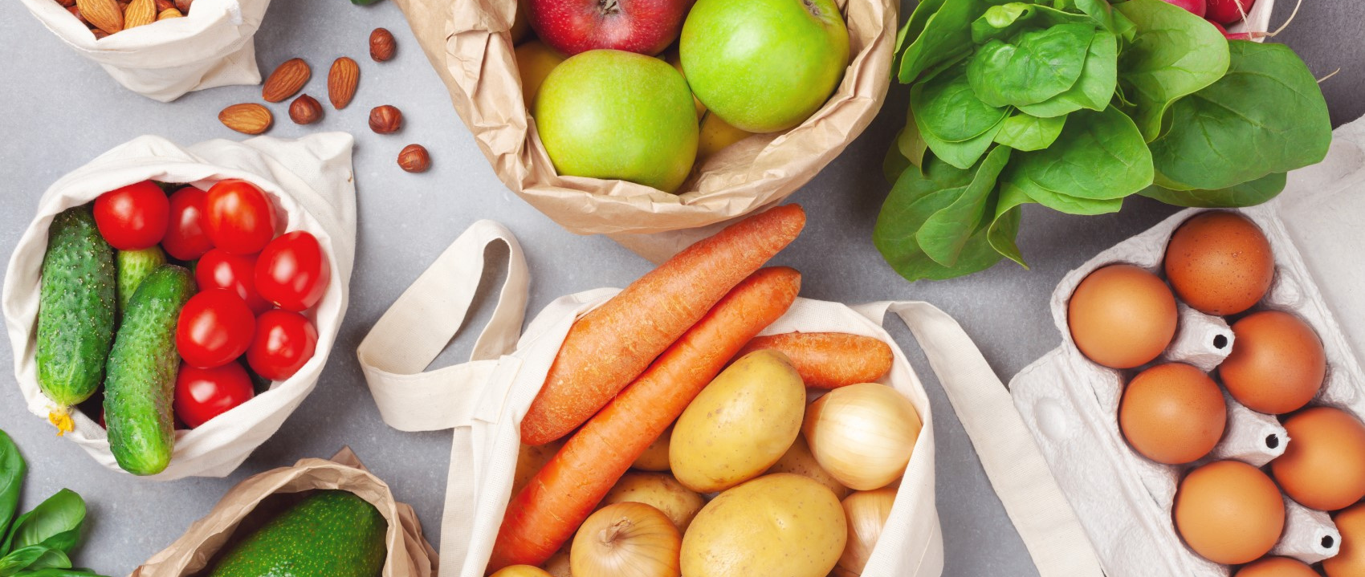
Solution
Online Farmers Market is a multi-vendor webapp that connects farmers directly to consumers, eliminating the need for middlemen. Our platform provides farmers with access to a wider market, higher prices, and increased visibility. Consumers can easily browse and purchase fresh produce directly from the source, knowing they are supporting small-scale farmers and they are guaranteed clean and fresh quality products at affordable prices at their door steps.
Online Farmer's Market
Page 4

Slide 5
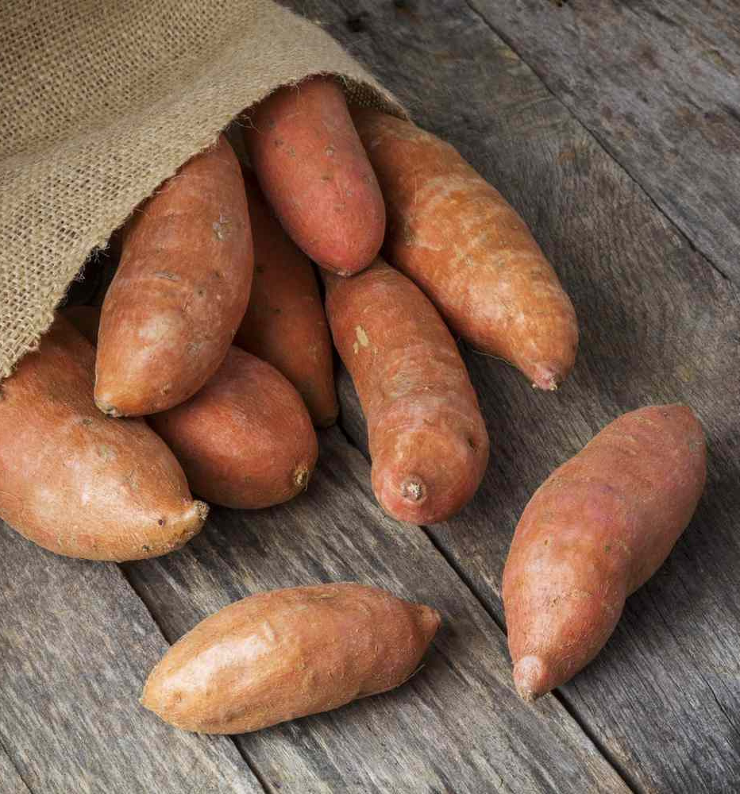
Market
THE MARKET POTENTIAL FOR ONLINE FARMER'S MARKET IS ENORMOUS. THE GLOBAL AGRICULTURE INDUSTRY IS PROJECTED TO REACH $12 TRILLION BY 2025, WITH THE E-COMMERCE SECTOR GROWING AT A CAGR OF 12.5%. IN ADDITION, THE DEMAND FOR LOCALLY SOURCED AND SUSTAINABLY GROWN FOOD IS ON THE RISE, PRESENTING A UNIQUE OPPORTUNITY FOR SMALL-SCALE FARMERS.
TARGET MARKET
FARMERS (VENDORS)
CUSTOMERS WHO ARE IN NEED OF HEALTHY FRESH AND EASILY ACCESSIBLE FARM PRODUCTS WHICH CAN BE DELIVERED TO THEM WITHOUT LEAVING THEIR LOCATION.
Online Farmer's Market
Page 5

Slide 6
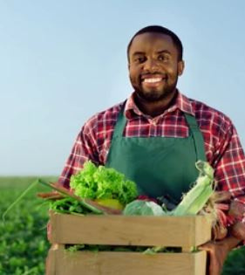
Competitive Advantage
Presentations are communication tools that can be used as demonstrations, lectures, speeches, reports, and more. It is mostly presented before an audience. It serves a variety of purposes, making presentations powerful tools for convincing and teaching.
Revenue Model
Presentations are communication tools that can be used as demonstrations, lectures, speeches, reports, and more.
It is mostly presented before an audience.
It serves a variety of purposes, making presentations powerful tools for convincing and teaching.
Online Farmer's Market
Page 6
Fresh Produce

Slide 7
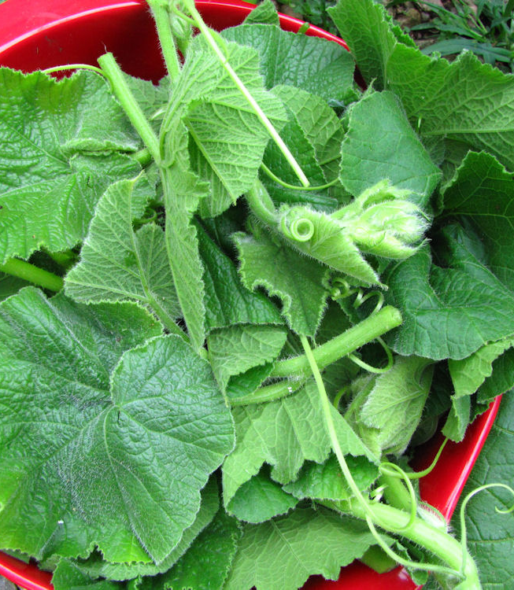

Future Plans
IN THE FUTURE, WE PLAN TO EXPAND OUR PLATFORM TO INCLUDE ADDITIONAL FEATURES SUCH AS FARM-TO-TABLE RESTAURANT PARTNERSHIPS AND SUBSCRIPTION BOXES. WE ALSO PLAN TO EXPAND GLOBALLY, STARTING WITH EMERGING MARKETS WHERE SMALL-SCALE FARMERS FACE EVEN GREATER CHALLENGES.
Online Farmer's Market
Page 7

Slide 8



Meet The Team
James Chisha
Nandila Mulilalila
Zoey Zack
CEO
CTO
Creative Manager
Online Farmer's Market
Page 8

Slide 9

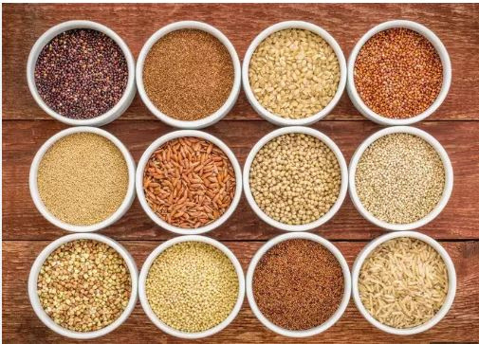


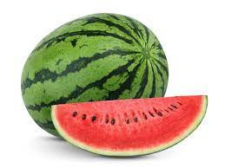



Stay in
Touch!
onlinefarmer'smarke@hmail.com
(+260) 456 789 056
123 Burma ST.
,Lusaka,
Online Farmer's Market
Page 9

Slide 10
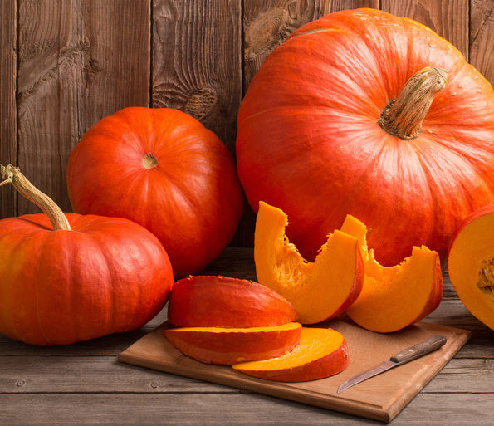
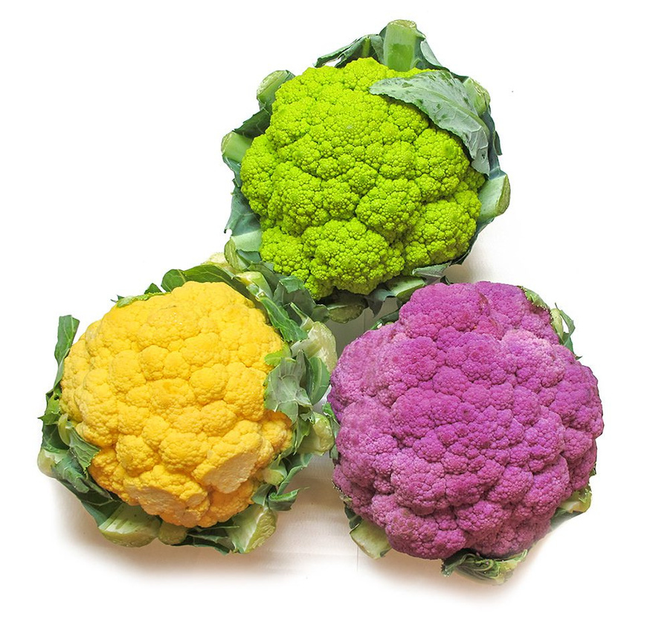
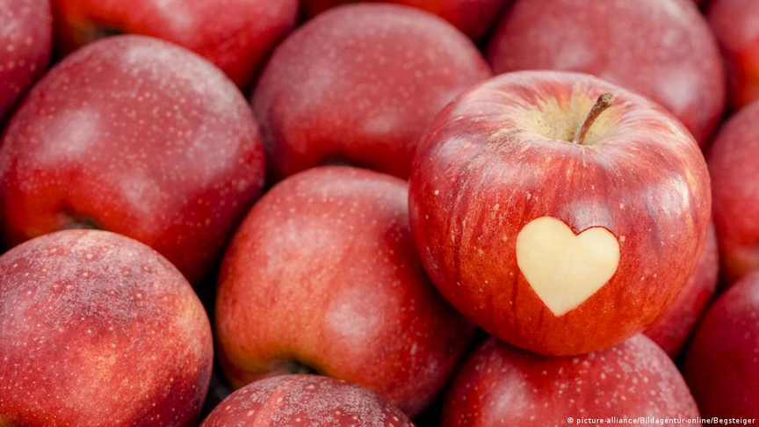
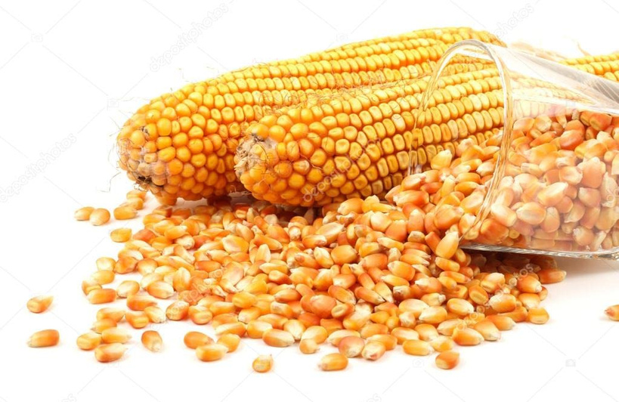
By Nandila Mulilalila CTO
Online Farmer's Market
Page 10

